Slide 1


Slide 2
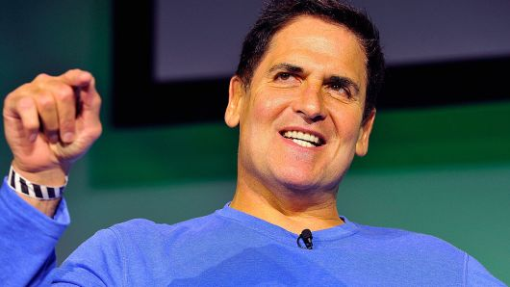
Machine Learning
“Artificial Intelligence, deep learning, machine learning — whatever you’re doing if you don’t understand it — learn it. Because otherwise you’re going to be a dinosaur within 3 years.” ~Mark Cuban

Slide 3
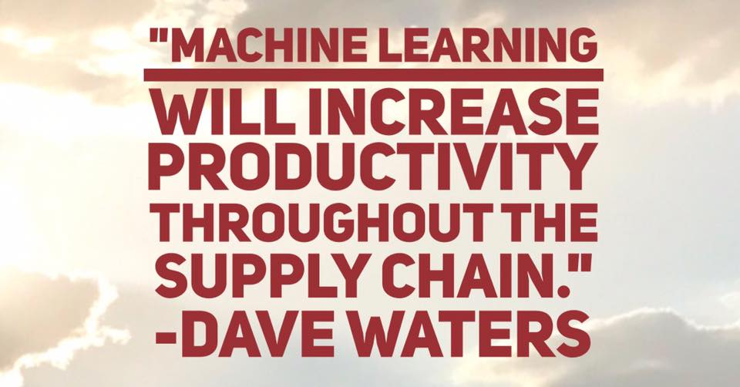

Slide 4

A Branch of Artificial Intelligence
Creative Use of Statistics
Smart Decisions from Large Datasets

Slide 5
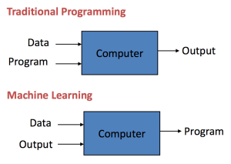
Traditional programming vs Machine Learning

Slide 6

Machine Learning
Gives ability to learn
with Data
Without explicitly program

Slide 7
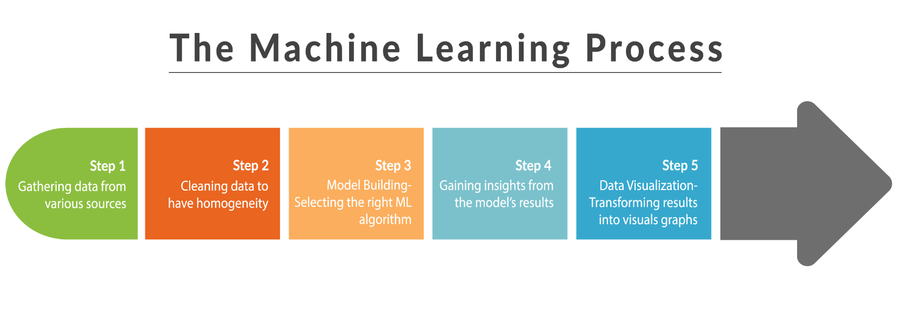
The Machine Learning Process

Slide 8
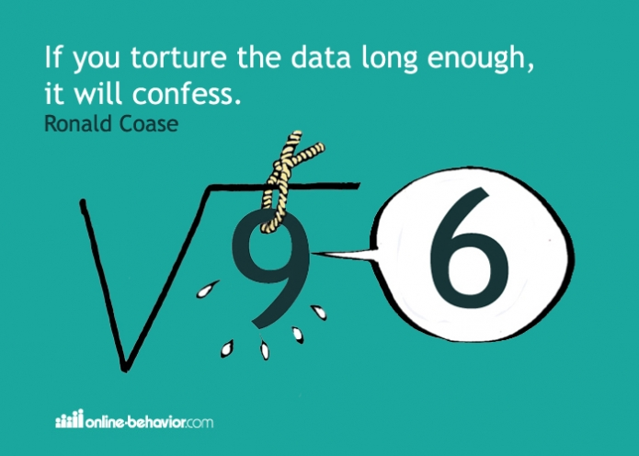
More data beats clever algorithms, but better data beats more data.
Peter Norvig

Slide 9
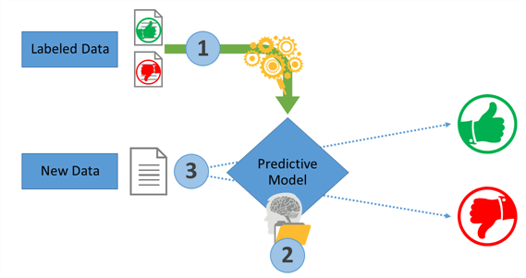
Classification Of Machine Learning
a.) Supervised Learning

Slide 10
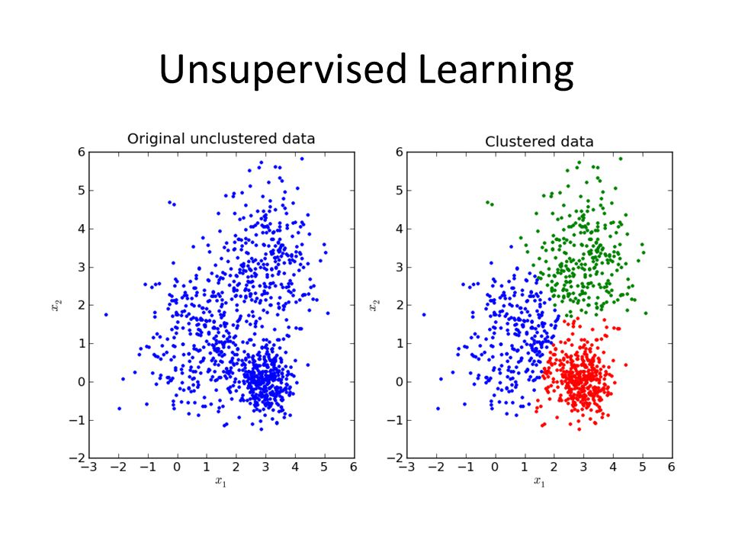
b.) Unsupervised Learning

Slide 11
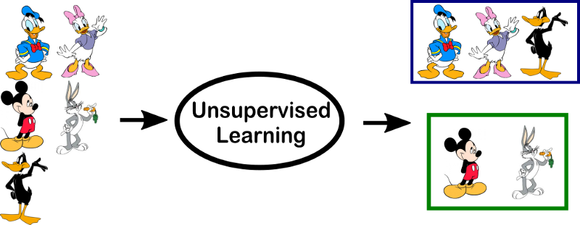
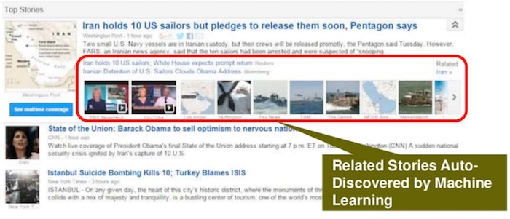

Slide 12
Two types of Machine Learning Algorithms
Classification Algorithms
Regression Algorithms

Slide 13
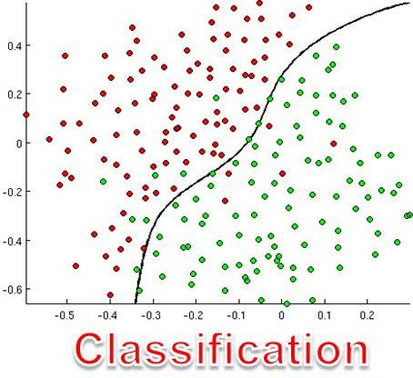
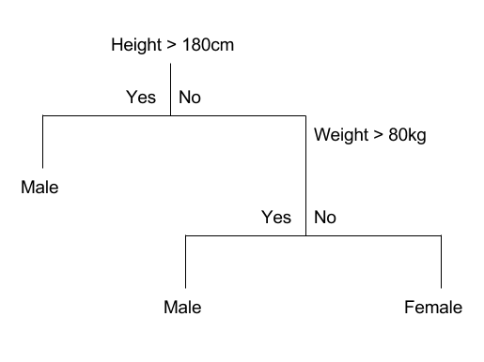
A.) Classification Algorithm
Classification Tree

Slide 14

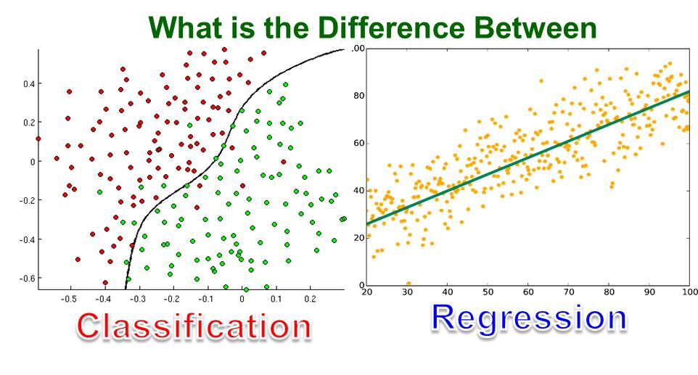
B.) Regression Algorithm
Regression Tree

Slide 15
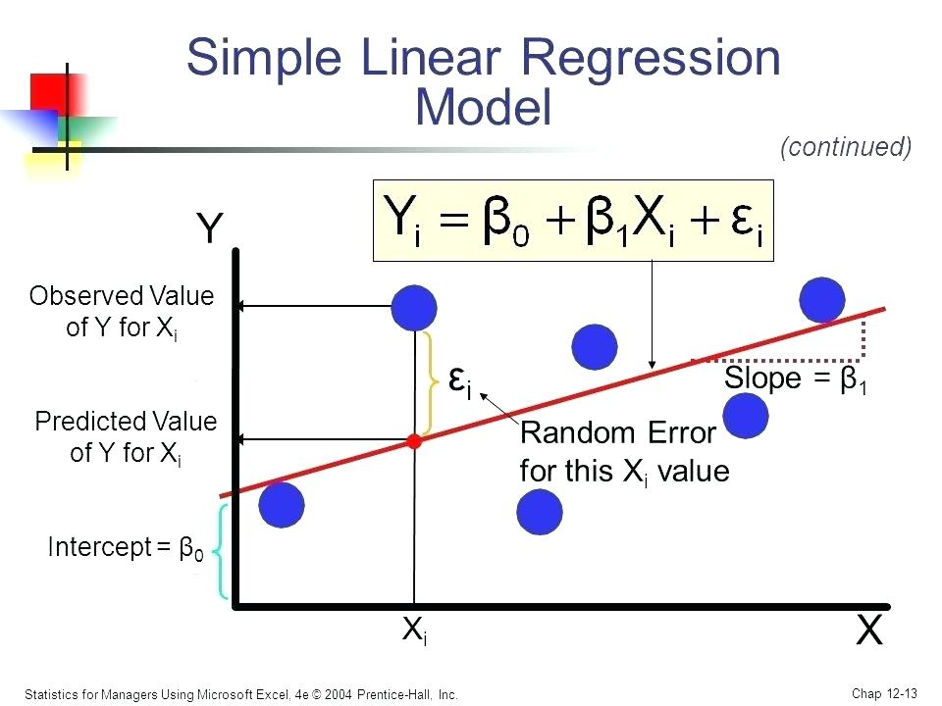

Slide 16
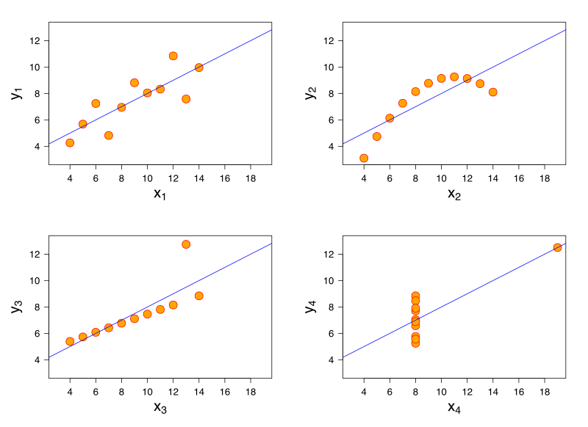
When not to Use Linear Regression??

Slide 17
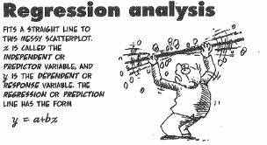

Slide 18
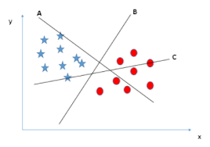
Support Vector Machine
Supervised ML algorithm
Both classification and regression
Hyper Plane

Slide 19
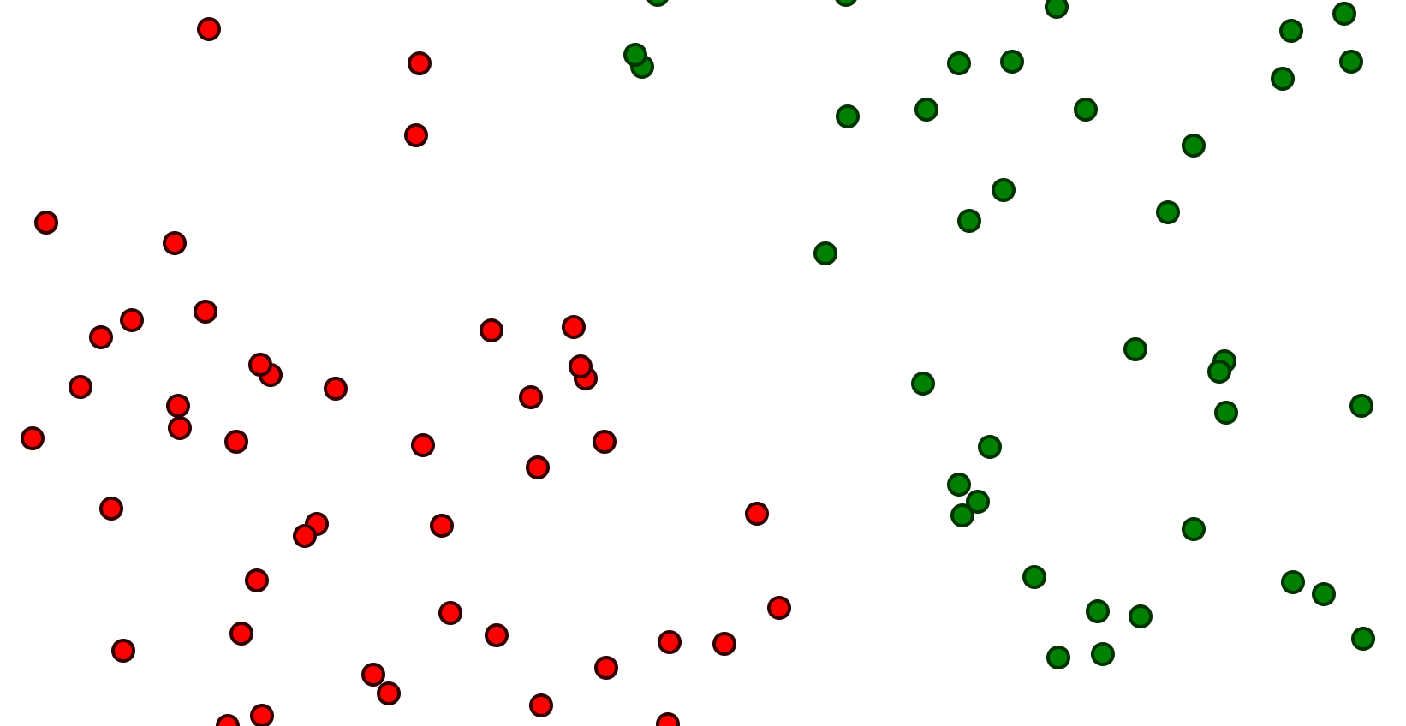
Input Data Points

Slide 20
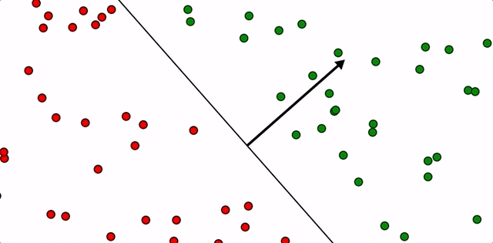
SVM Animation

Slide 21
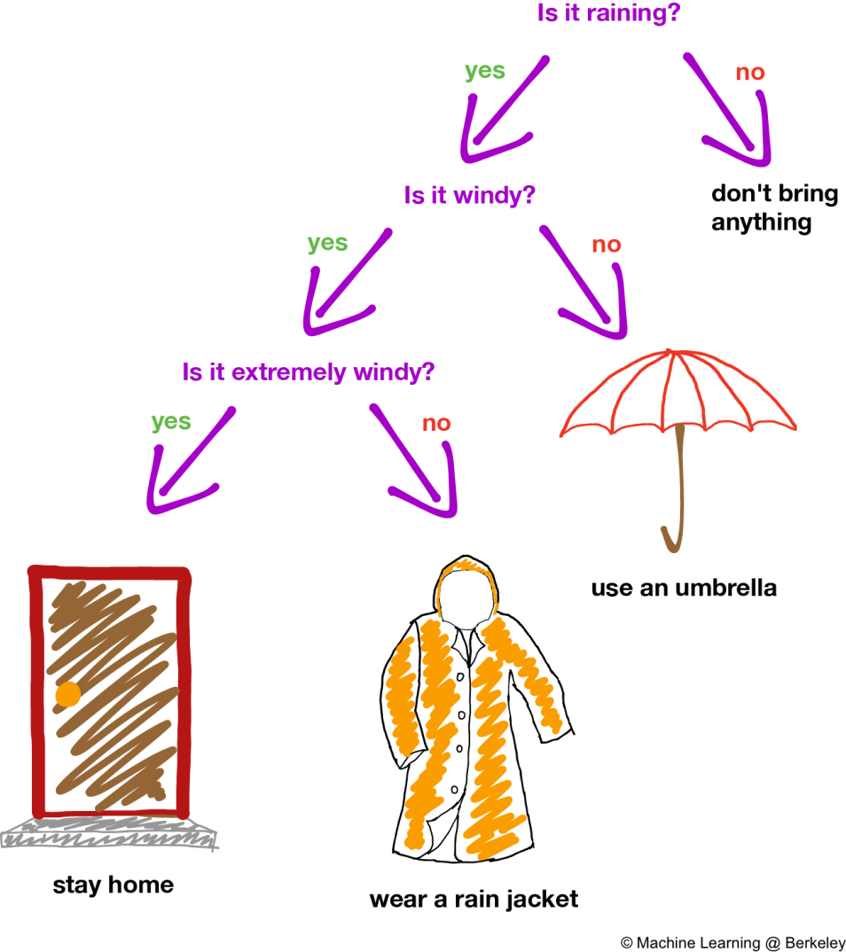
Decision Trees
Observations about item to conclusions about target variable.
Predict value for target variable – categorical or continuous.

Slide 22
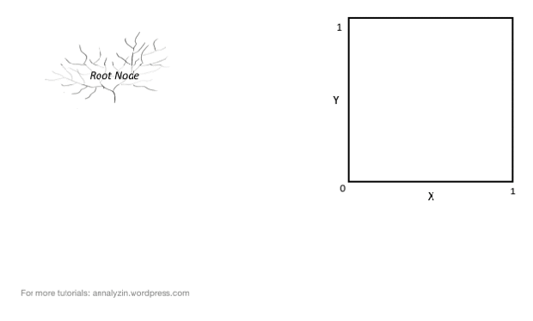
Decision Tree Animation
Step 1: Question that split data points into 2 groups that are most homogeneous
Step 2: Repeat Step 1, until a stopping criterion is reached

Slide 23
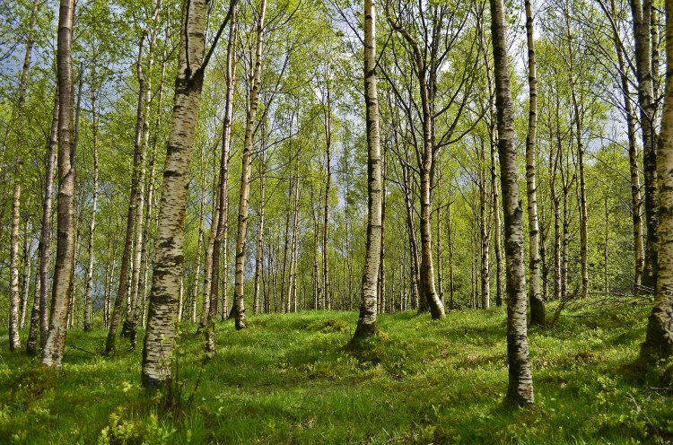
Random Forests

Slide 24
What , How??????
Supervised Learning Algorithm
Both classification and regression problems
Builds ensemble of trees trained with Bagging method
It takes a random subset of features while splitting a node

Slide 25

Random Forest Simplified

Slide 26
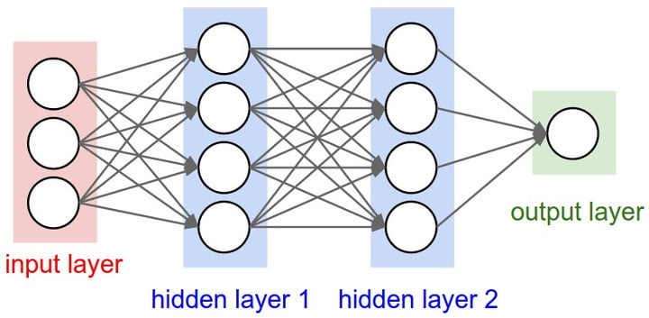
Neural Networks
Inspired by neurons in our nervous system
Input, Output and Hidden
Breaks down problems into smaller sub problems

Slide 27
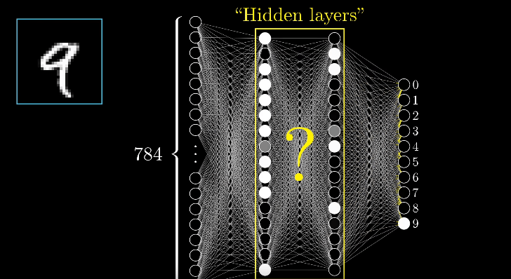
ANNs in Deep Learning
Represent a problem as hierarchy of concepts.
Break a complex task into less abstract tasks.

Slide 28
Problem Statement
Notes:
For any issue the IT team would develop a solution , without taking into the account the possibility of a duplicate.

Slide 29
My Project
Text Analytics based - Recommender System

Slide 30

Document Classification
2 Main Philosophies of Subject Classification
Content-based
Request based
Notes:
The documents to be classified may be texts, images, music, etc. Each kind of document possesses its special classification problems. When not otherwise specified, text classification is implied.
Documents may be classified according to their subjects or according to other attributes (such as document type, author, printing year etc.).

Slide 31
Content-based
Document have certain attributes .
Based on No. of attributes matched
documents are assigned a similarity score.

Slide 32
Request-based
Request from users influence how documents are classified
Feedback from users are taken
These feedbacks are analysed and based on them classification is done.

Slide 33
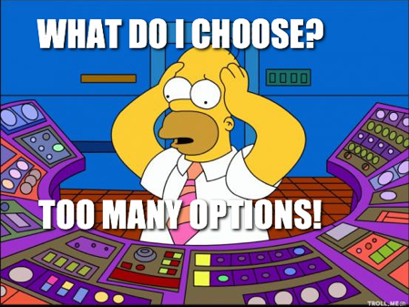
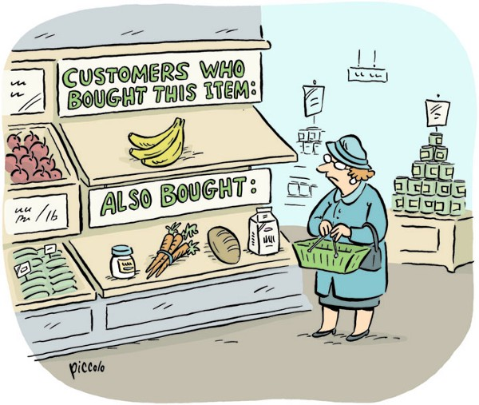
Recommender Systems

Slide 34
What is recommender systems??
Technology where items are recommended to users (or vice-versa e.g. Uber)
Knowledge Based recommender systems
Both users and items have attributes.
The more you know about both, the better the results are.

Slide 35
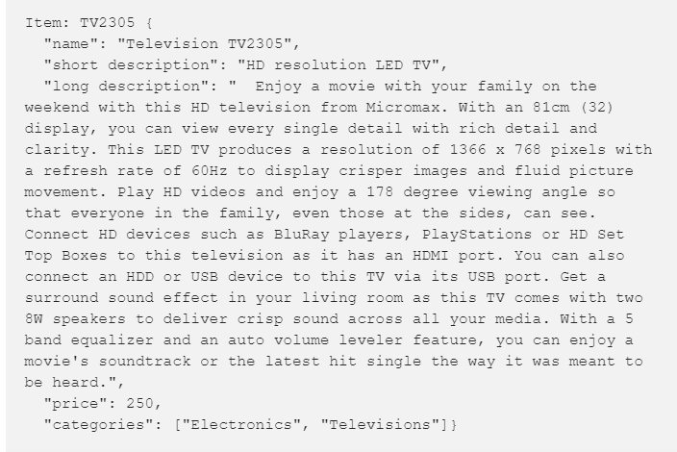
Attributes - useful information - rules & patterns used for recommendation
Item - several attributes – Similarity of items
Recommendations - based on item similarity
Users described by similar attributes
Recommend items based on user-item similarity

Slide 36
Content-Based Filtering
 | Inside Out | Minions | Avengers | Ant-Man
Animated | Yes | Yes | No | No
Marvel | No | No | Yes | Yes
Super Villain | No | Yes | Yes | Yes
Bechdel Test | Pass | Fail | Pass | Fail
Parks and Rec Alumini | Yes | Yes | No | Yes
No. of Similar features |  | 3 | 1 | 1

Slide 37
Steps Involved
Tokenization
Removing Stop words and punctuation
Generate features or attributes
Classification
Notes:
Tokenization – Parsing text data into smaller units as words and phrases .e.g. BagOfWords
Remove sp and punc
Generate features or attributes – tf-idf
Classification based on the features we generated

Slide 38
Tfidf vectorizer to rescue
TF-IDF : "Term Frequency, Inverse Document Frequency."
Way to score the importance of words (or "terms") in a document based on how frequently they appear across multiple documents.

Slide 39
Tf-idf
Intuitively…
If a word appears frequently in a document, it's important. Give the word a high score.
But if a word appears in many documents, it's not a unique identifier. Give the word a low score.
Tf-idf term weighting:
tf-idf(t,d) = tf(t,d) * idf(t)

Slide 40
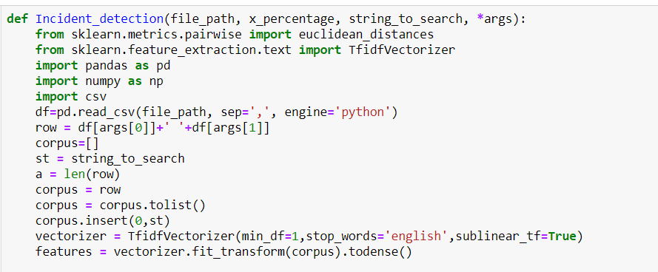
Tf-idf code

Slide 41
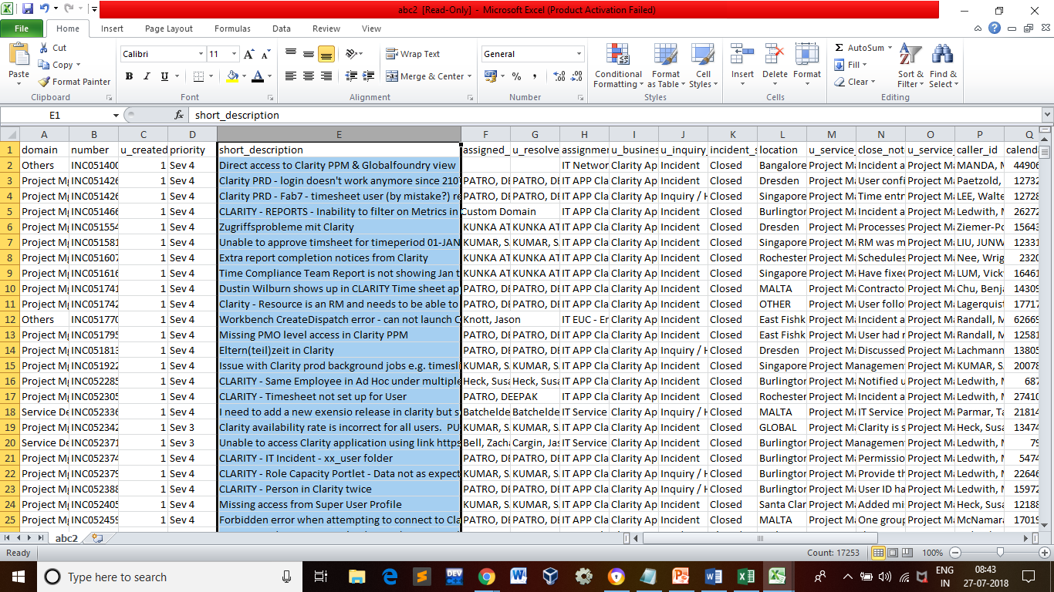
Incidents Data

Slide 42

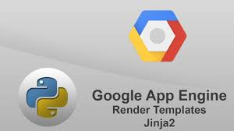
Google App Engine
GAE - web framework and cloud computing platform
Developing and hosting web applications in Google-managed data centres

Slide 43

HAVE AN ISSUE?? Here is your AI Buddy to help
“It thinks, all thanks to me”

Slide 44
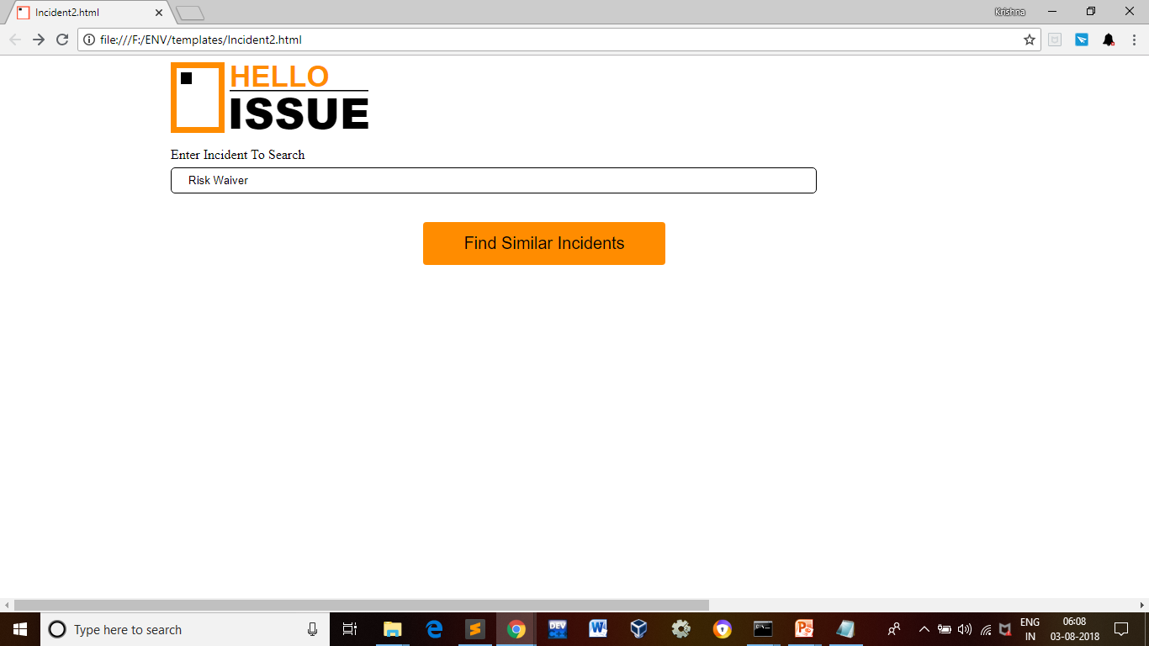
Hello Issue App

Slide 45
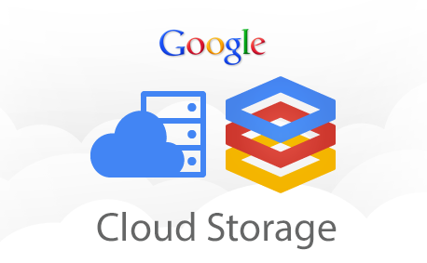
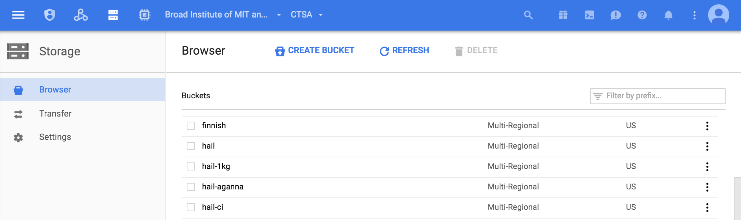
Data file on Google Cloud Storage

Slide 46
Flow of App
Print.html
(Similar Incident in a table)
Yes
Incident.html
(Incident Search Form)
Similar Incident found?????
Notfound.html
No

Slide 47


Slide 48


Slide 49
Recommender Systems

Slide 50
What is recommender systems??
Technology where items are recommended to users (or vice-versa e.g. Uber)
Knowledge Based recommender systems
Both users and items have attributes.
The more you know about both, the better the results are.

Slide 51
Attributes - useful information - rules & patterns used for recommendation
Item - several attributes – Similarity of items
Recommendations - based on item similarity
Users described by similar attributes
Recommend items based on user-item similarity

Slide 52
Content-Based Filtering
 | Inside Out | Minions | Avengers | Ant-Man
Animated | Yes | Yes | No | No
Marvel | No | No | Yes | Yes
Super Villain | No | Yes | Yes | Yes
Bechdel Test | Pass | Fail | Pass | Fail
Parks and Rec Alumini | Yes | Yes | No | Yes
No. of Similar features |  | 3 | 1 | 1

Slide 53


Slide 54

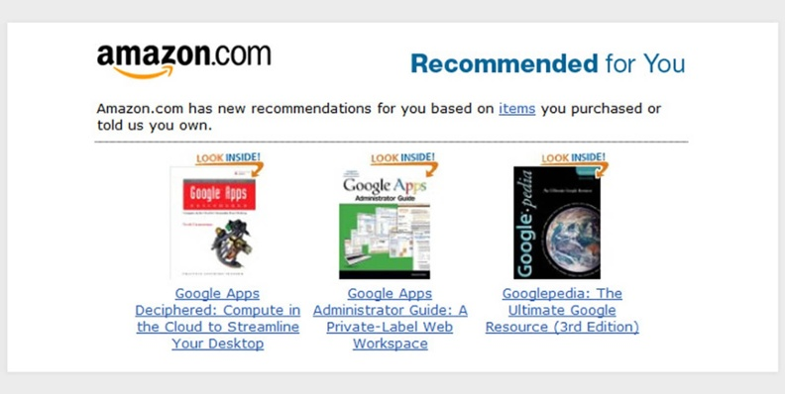
Use Cases

Slide 55

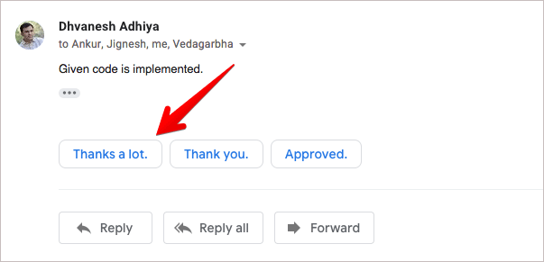
Use Cases

Slide 56
Our Problem Statement

Slide 57
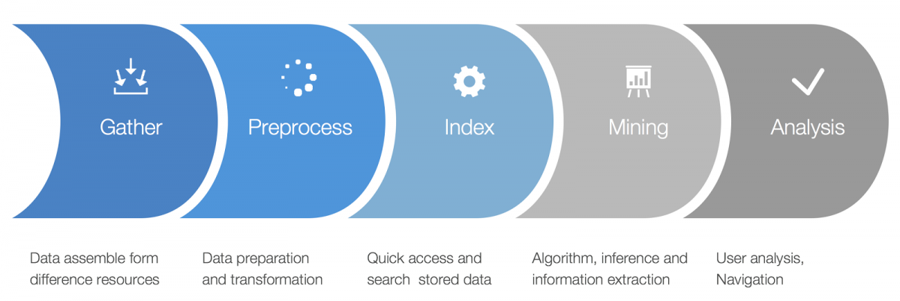
Text Mining
Examine large collections of written resources
Transform unstructured text into structured data(bag of words)
Here words, sentences, phrases become features

Slide 58
Tfidf vectorizer to rescue
TfidfVectorizer()
Tf-idf term weighting:
tf-idf(t,d) = tf(t,d) * idf(t)

Slide 59
Tf-idf code

Slide 60
Google App Engine
GAE - web framework and cloud computing platform
Developing and hosting web applications in Google-managed data centres

Slide 61
“Aim for simplicity in Data Science. Real creativity won’t make things more complex. Instead, it will simplify them.” ― Damian Duffy Mingle

Slide 62
HAVE AN ISSUE?? Here is your AI Buddy to help
“It thinks, all thanks to me”

Slide 63
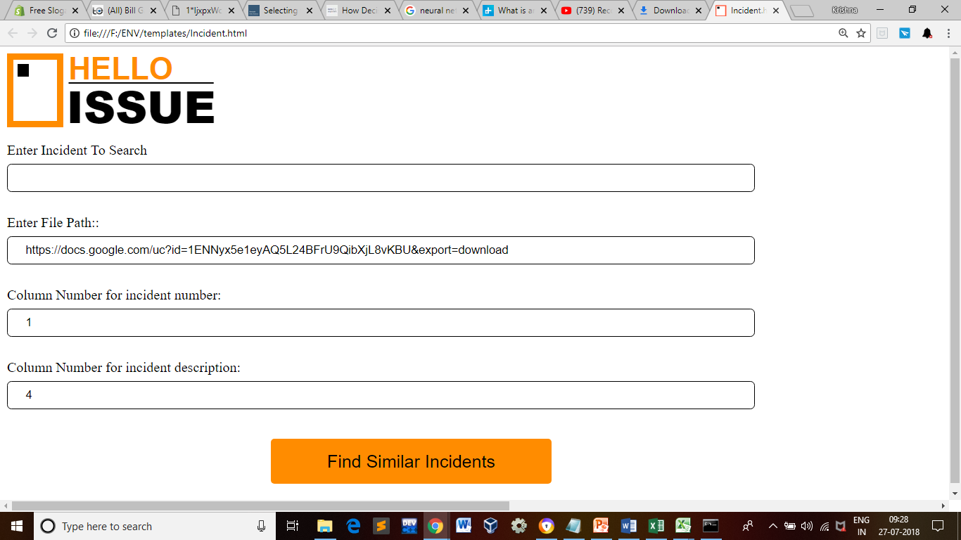
Hello Issue App

Slide 64
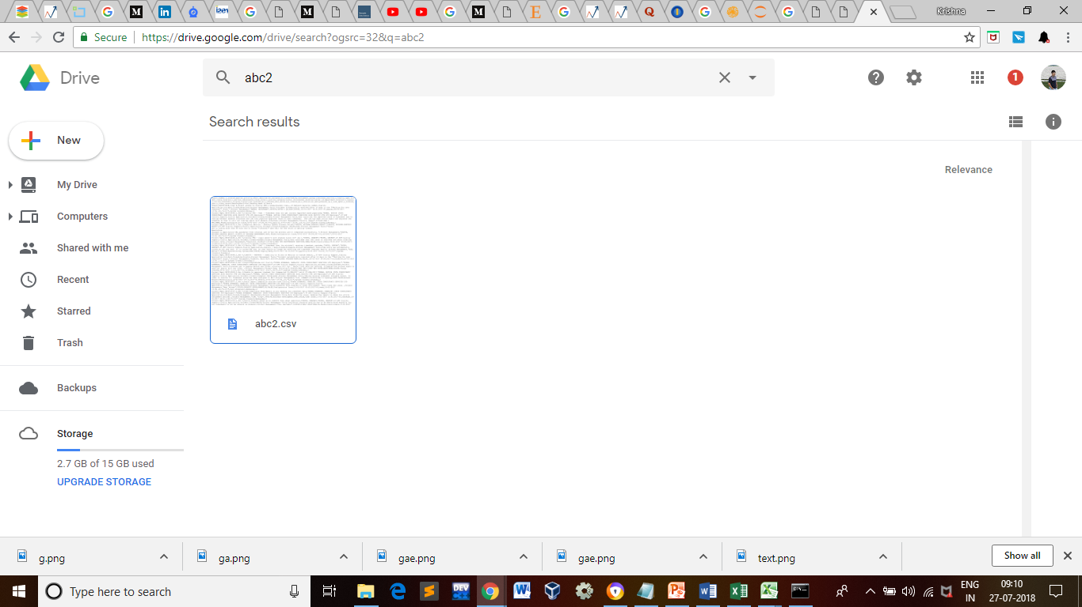
Data file on Google Drive

Slide 65
Flow of App
Print.html
(Similar Incident in a table)
Yes
Incident.html
(Incident Form)
Similar Incident found?????
Notfound.html
No

Slide 66
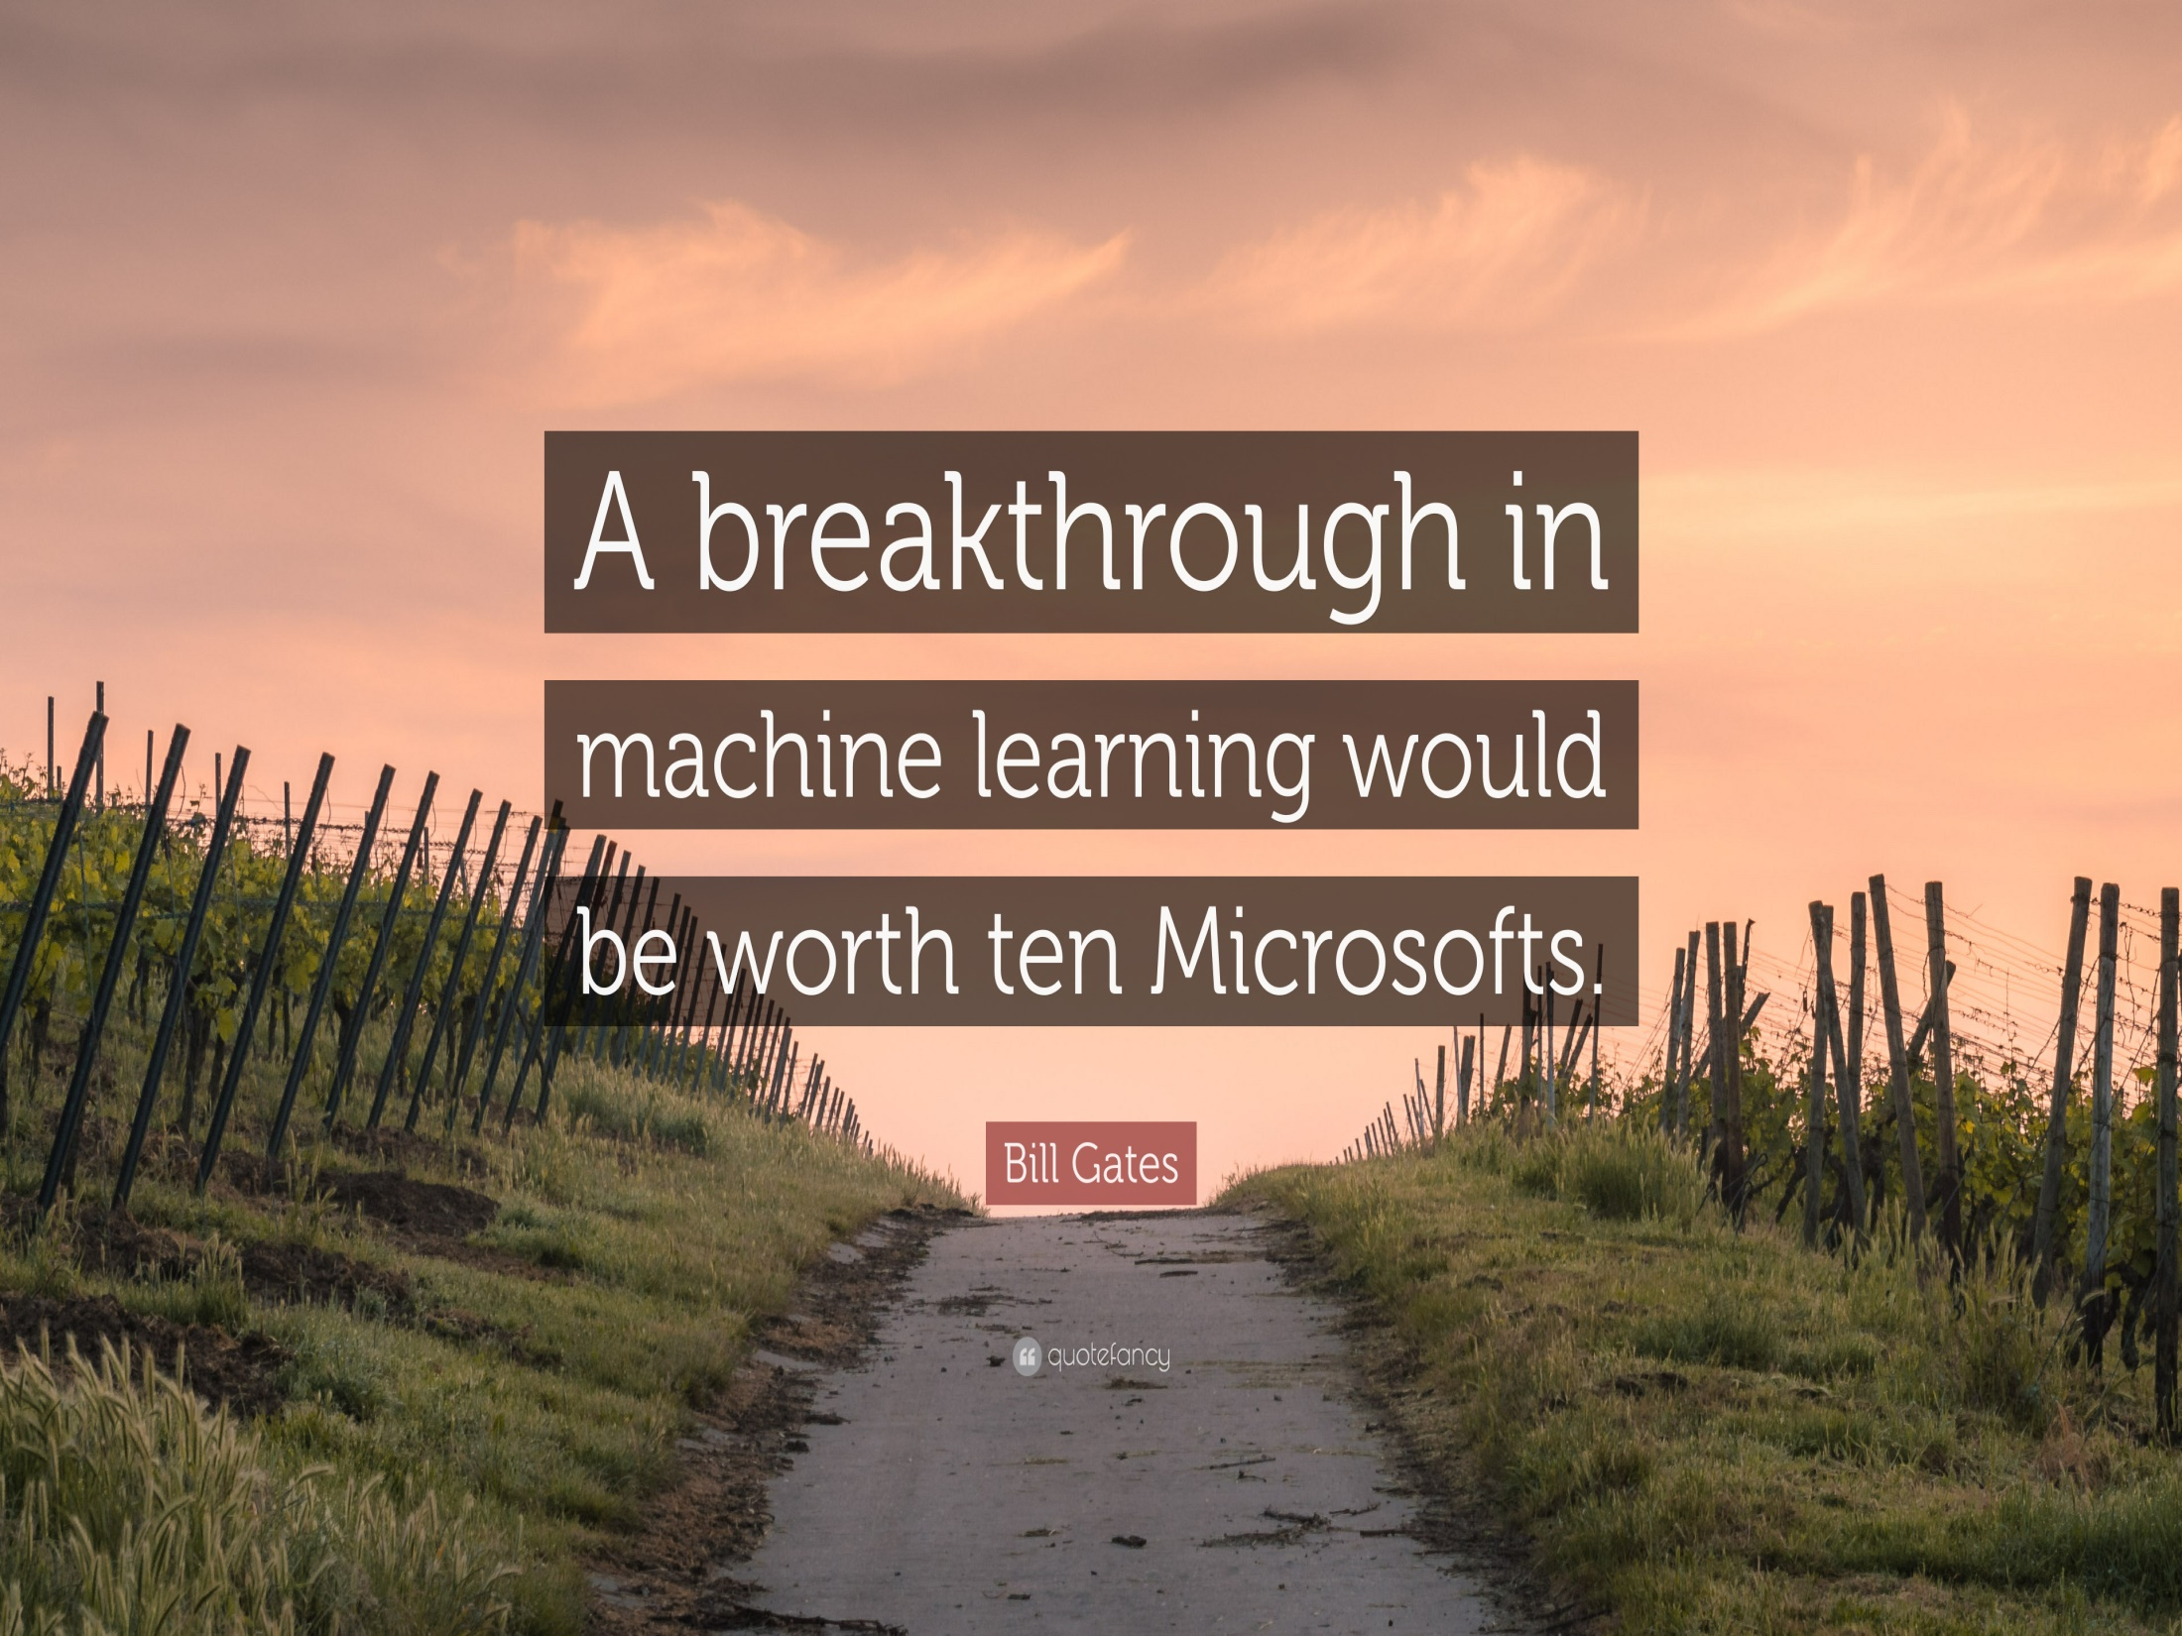

Slide 68


